Slide 1
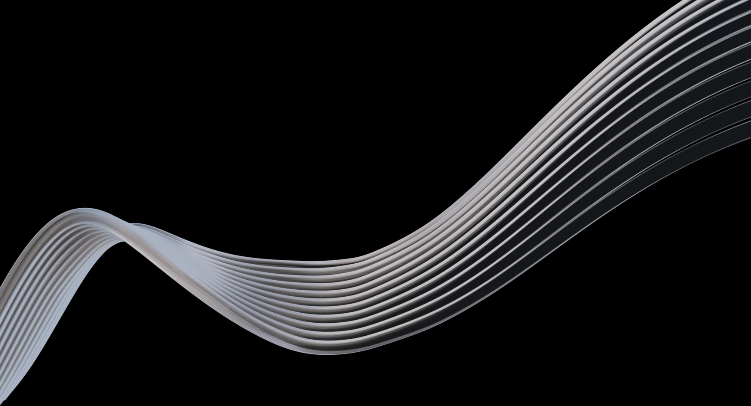


Warehouse Slotting Optimizer
Guide: Ms . Chandusha Asst.Prof.,CS&IT
2520090213-Ramya
2520080009-krishnasree

Slide 2
ABSTRACT
Warehouse throughput depends significantly on product placement.
Products frequently picked together should ideally be stored close to each other.
Poor slot allocation increases picker travel distance and order ful fillment time.
The proposed system analyzes historical order and SKU data to identify co-pick patterns.
Apriori / FP-Growth is used to discover frequently co-picked products.
Product relationships are converted into an affinity matrix.
An optimization algorithm assigns products to suitable storage slots.
The objective is to minimize expected picking travel while satisfying warehouse constraints.
The optimized layout is evaluated against the existing layout.

Slide 3
INTRODUCTION
Background:
Warehouses store a large number of products across multiple storage locations.
Order picking is one of the most time-consuming warehouse operations.
A significant amount of picker time can be spent travelling between storage locations.
Traditional slotting often relies on manual decisions or product demand alone.
Problem:
Frequently co-picked products may be stored far apart.
This causes:
  Increased travel distance
  Longer picking time
  Higher labor effort
  Reduced warehouse throughput
Objective:
Analyze historical orders.
Discover product co-pick relationships.
Assign related products to nearby slots.
Minimize expected picker travel distance.

Slide 4
Software & Hardware Requirements:
Software
Python 3.x
Google Colab / Jupyter Notebook
Pandas & NumPy
Mlxtend — Apriori / FP-Growth
Scikit-learn
Matplotlib / Plotly
Streamlit — Dashboard
Hardware
Intel i3/i5 or equivalent
8 GB RAM or higher
20 GB storage
Windows / Linux / macOS
Internet connection

Slide 5
Literature survey:
Association Rule Mining: Apriori and FP-Growth identify frequently co-occurring products.
Warehouse Slotting: Determines suitable locations based on demand, accessibility, and product characteristics.
Order Picking: Research focuses on reducing picker travel and fulfillment time.
Optimization: Genetic Algorithms, Simulated Annealing, and Greedy methods solve complex slot-assignment problems.
Research Gap: Existing approaches often focus on individual product demand; our approach combines co-pick affinity with slot distance.

Slide 6
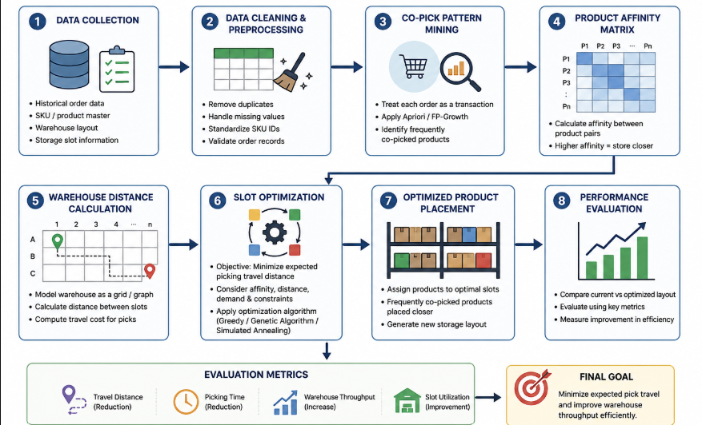
Methodology:
Data Collection → Order & SKU data
Data Cleaning → Remove errors & duplicates
Co-Pick Mining → Find frequently paired products
Affinity Analysis → Measure product relationships
Slot Optimization → Assign products to nearby slots
Evaluation → Measure travel time & throughput

Slide 7
THANK YOU

